Slide 1
Time Series Statistical Models
Lesson 10.2

Slide 2
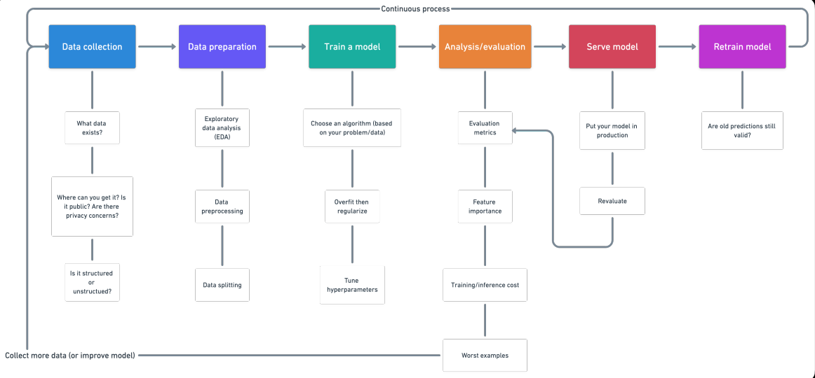
05 Build Loan Approver - Steps in building ML Model

Slide 3
Homework- Summary
Predict future movements in the value of the Japanese yen versus the U.S. dollar (future direction and risk of various currencies)
Time-Series Forecasting | Linear Regression Forecasting
Load historical Dollar-Yen exchange rate futures data & apply time series analysis and modeling to determine whether there is any predictable behavior. Decomposition using a Hodrick-Prescott Filter (Decompose the Settle price into trend and noise). Forecasting Returns using an ARMA Model. Forecasting the Settle Price using an ARIMA Model. Forecasting Volatility with GARCH | Scikit-Learn linear regression model to predict Yen futures ("settle") returns with lagged Yen futures returns and categorical calendar seasonal effects (e.g., day-of-week or week-of-year seasonal effects). Data Preparation (Creating Returns and Lagged Returns and splitting the data into training and testing data) Fitting a Linear Regression Model. Making predictions using the testing data. Out-of-sample performance. In-sample performance.
Questions from section Based on your time series analysis, would you buy the yen now? Is the risk of the yen expected to increase or decrease? Based on the model evaluation, would you feel confident in using these models for trading? | Questions from section Does this model perform better or worse on out-of-sample data compared to in-sample data?

Slide 4
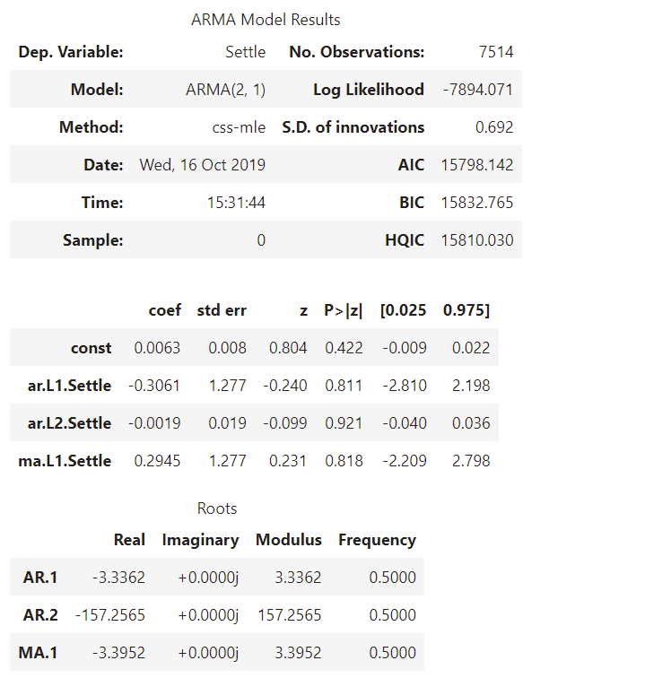
Homework -Time-Series Forecasting
ARMA with order (2,1)
Question: Based on the p-value, is the model a good fit?
The model summary reveals a lot of information. The table in the middle is the coefficients table where the values under ‘coef’ are the weights of the respective terms.
Coefficient of the AR or MA terms
P-Value in ‘P>|z|’ column should ideally be less than 0.05 for the respective X to be significant.
Resolution – If your model is not performing well, you need to add additional input variables or adjust the lag order (Underfitting)

Slide 5
Underfitting - Resolution
Resolution Category | Resolution details
Increasing the model complexity | Model may be underfitting simply because it is not complex enough to capture patterns in the data. Using a more complex model, for instance by switching from a linear to a non-linear model or by adding hidden layers to your neural network, will very often help solve underfitting.
Adding features to training data | Training data may lack the features that will make the model detect the relevant patterns to make accurate predictions. Adding features (new/engineered features) and complexity to your data can help overcome underfitting.
Increase the duration of training | Increase the number of epochs or increase the duration of training to get better results.
Address data noise | Remove noise from the data

Slide 6
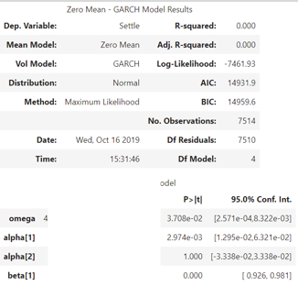
Homework –Volatility with GARCH
In practice, in financial markets, it's easier to forecast volatility than it is to forecast returns or prices
In practice, in financial markets, it's easier to forecast volatility than it is to forecast returns or prices
Time-Series Forecasting
Rather than predicting returns, let's forecast near-term **volatility** of Japanese Yen futures returns. Being able to accurately predict volatility will be extremely useful if we want to trade in derivatives or quantify our maximum loss. Using futures Settle *Returns*, estimate an GARCH model GARCH: Create an GARCH model and fit it to the returns data. Note: Set the parameters to p=2 and q=1: order=(2, 1). Output the GARCH summary table and take note of the p-values of the lags. Based on the p-values, is the model a good fit (p < 0.05)? Plot the 5-day forecast of the volatility.
# Estimate a GARCH model: model = arch.arch_model(returns, mean="Zero", vol="GARCH", p=2, q=1)
# Find the last day of the dataset last_day = returns.index.max().strftime('%Y-%m-%d')
# Start the forecast using the last_day calculated above forecasts = results.forecast(start=last_day, horizon=forecast_horizon)
Question: Based on the p-value, is the model a good fit?
Coefficient of the AR or MA terms
P-Value in ‘P>|z|’ column should ideally be less than 0.05 for the respective X to be significant.

Slide 7

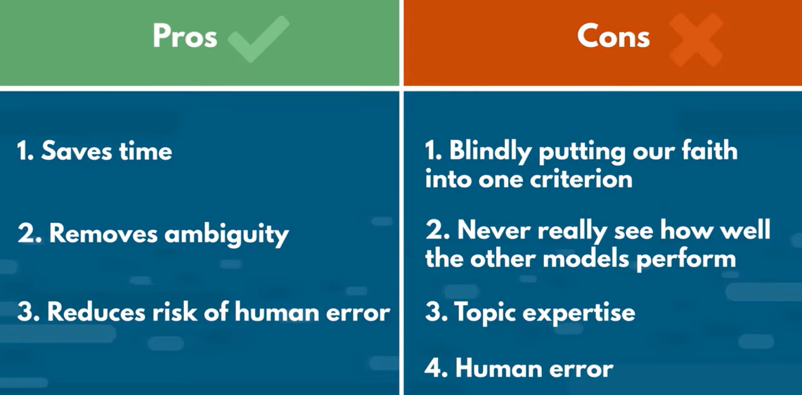
Autoarima
Recommends the best model based on AIC or BIC score
Need to understand and apply the parameter
Time consuming (Need CPU/GPU) – depending on the parameters provided

Slide 8
Autoarima - parameters
Parameters | Explanation
y | time-series to which to fit the ARIMA estimator.
X | An optional 2-d array of exogenous variables. Variables are used as additional features in the regression operation
seasonal | Whether to fit a seasonal ARIMA. Default is True
stationary | Whether the time-series is stationary and d should be set to zero.
information_criterion | criterion used to select the best ARIMA model (default=’aic’)
stepwise | The stepwise algorithm can be significantly faster than fitting all (or a random subset of) hyper-parameter combinations and is less likely to over-fit the model.
start_p max_p | The starting value of p, the order (or number of time lags) of the auto-regressive (“AR”) model. The maximum value of p, inclusive. Must be a positive integer greater than or equal to start_p.
start_q max_q | The starting value of q, the order of the moving-average (“MA”) model. Must be a positive integer. The maximum value of q, inclusive. Must be a positive integer greater than start_q.
d max_d | The order of first-differencing. If None (by default), the value will automatically be selected based on the results of the test The maximum value of d, or the maximum number of non-seasonal differences. Must be a positive integer greater than or equal to d.
start_P | The starting value of P, the order of the auto-regressive portion of the seasonal model.
D & max_D | The order of the seasonal differencing, The maximum value of D
start_Q /max_Q | The starting value of Q, the order of the moving-average portion of the seasonal model & max_Q
Notes:
https://alkaline-ml.com/pmdarima/modules/generated/pmdarima.arima.auto_arima.html

Slide 9
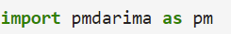
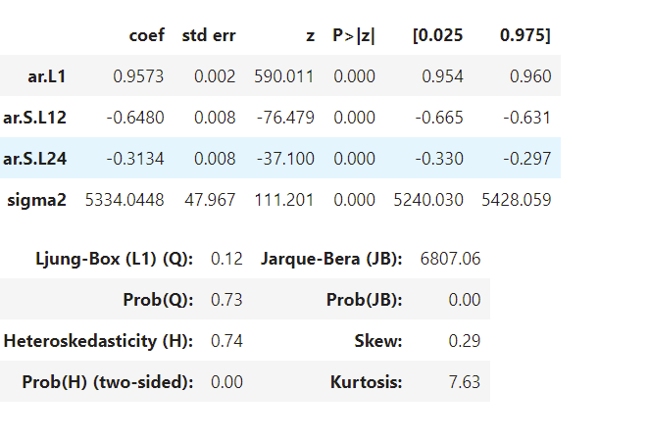
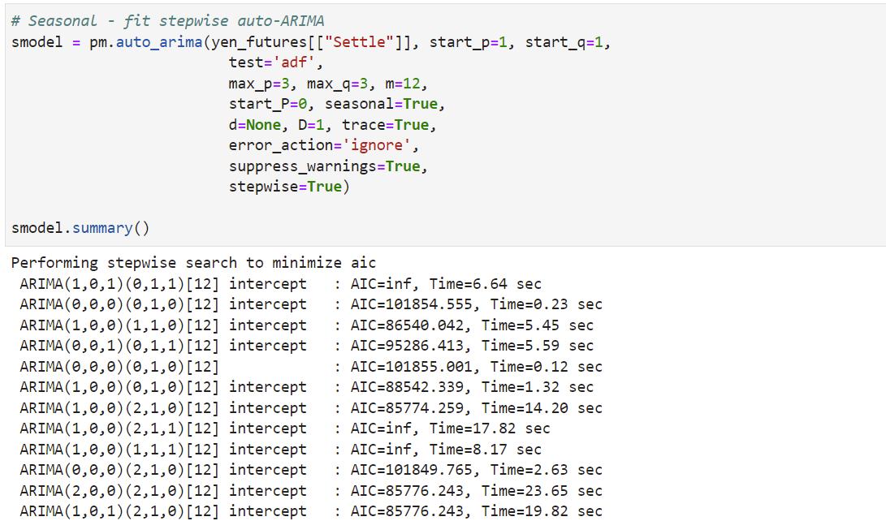
Autoarima
Need to install the package
Provides you the optimal model

Slide 10
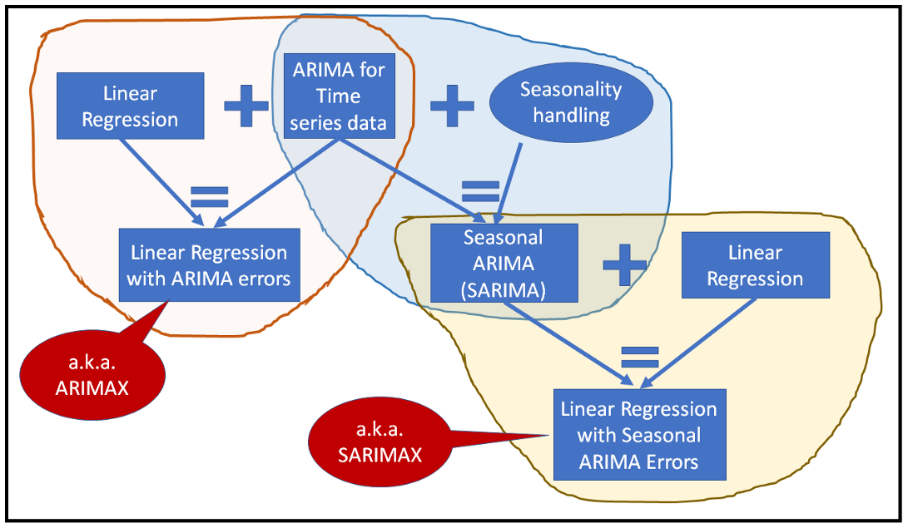
Combination of Models
Notes:
https://alkaline-ml.com/pmdarima/modules/generated/pmdarima.arima.auto_arima.html

Slide 11
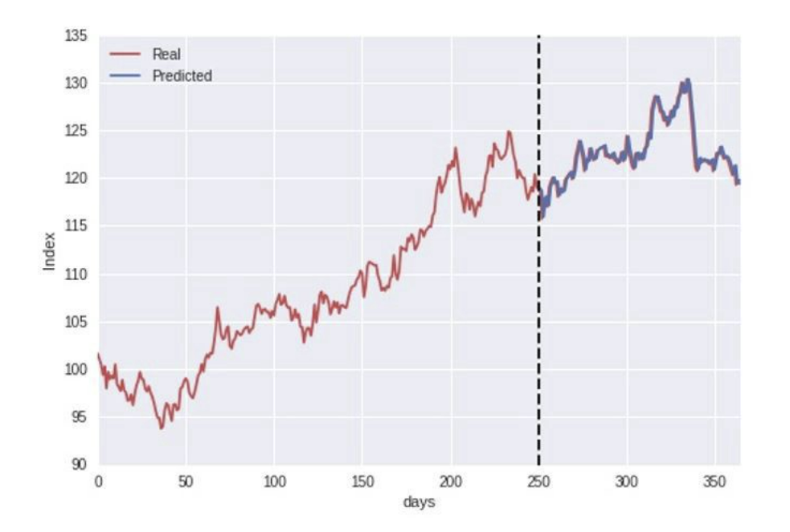
ARIMA-GARCH forecasting with Python
Options
Time series is first fitted with a conditional mean model like AR or ARMA and ARCH/GARCH model is applied to the residuals of the fitted AR/ARMA model
Fit an ARMA-GARCH model in one shot
Transform the original prices Pt to logarithmic returns rt:=ln(Pt)−ln(Pt−1) and then employ a GARCH model
ARMA is a mean model, whereas GARCH is a variance model.
If the underlying time series is known to be 0 mean, then we can apply GARCH directly.
Otherwise the mean needs to be estimated. If not, the dynamics of mean will leak into variance estimation and we will not be able to distinguish them

Slide 12
APPENDIX

Slide 13
Homework -Time-Series Forecasting
Time-Series Forecasting
Load historical Dollar-Yen exchange rate futures data yen_futures = pd.read_csv( Path("yen.csv"), index_col="Date", infer_datetime_format=True, parse_dates=True )
# Trim the dataset to begin on January 1st, 1990 yen_futures = yen_futures.loc["1990-01-01":, :]
# Plot just the "Settle" column from the dataframe: Identify Trends – Is there long-term stengthening or weakening of the Japanese Yen against the Dollar? Are there any trends 1-3 years vs daily?
# Apply the Hodrick-Prescott Filter by decomposing the "Settle" price into two separate series: #HP filter extracts the trend to enable smoothing effect
# Create a dataframe of just the settle price, and add columns for "noise" and "trend" series from above: futures_decomp = yen_futures[["Settle"]].copy() futures_decomp["noise"] = ts_noise futures_decomp["trend"] = ts_trend
# Plot the Settle Price vs. the Trend for 2015 to the present Are there any short term fluctuations that deviate around this trend. E.g. When the “Settle” price deviates far below the “Trend” → Yen is temporarily more undervalued than it should be (short-term buying opportunity).

Slide 14
Homework -Time-Series Forecasting
Time-Series Forecasting
Forecasting Returns using an ARMA Model returns = (yen_futures[["Settle"]].pct_change() * 100) #Replace inf and -inf with NaN, and then select non-null rows. returns = returns.replace(-np.inf, np.nan).dropna()
# Estimate and ARMA model using statsmodels (use order=(2, 1)) #Model, Fit model = sm.tsa.ARMA(returns, order=(2, 1))
#How to evaluate the model using summary()
model = ARIMA(yen_futures[["Settle"]], order=(5, 1, 1))
ARMA with order (2,1)
ARIMA with order=(5, 1, 1)

